Slide 1

CYBER SECURITY
Suspicious Web Threat Interactions – How to handle

Slide 2
Project Introduction
Language Machine learning, python, SQL, Excel
Tools VS code, Jupyter notebook
Domain Data Analyst
Project Difficulties level Advance

Slide 3
About Dataset
This dataset contains web traffic records collected through AWS CloudWatch, aimed
at detecting suspicious activities and potential attack attempts.
The data were generated by monitoring traffic to a production web server, using
various detection rules to identify anomalous patterns.

Slide 4
Context
In today's cloud environments, cybersecurity is more crucial than ever. The ability to
detect and respond to threats in real time can protect organizations from significant
consequences.
This dataset provides a view of web traffic that has been labeled as
suspicious, offering a valuable resource for developers, data scientists, and security
experts to enhance threat detection techniques.

Slide 5
Dataset Content
Each entry in the dataset represents a stream of traffic to a web server, including the
following columns:
bytes_in: Bytes received by the server.
bytes_out: Bytes sent from the server.
creation_time: Timestamp of when the record was created.
end_time: Timestamp of when the connection ended.
src_ip: Source IP address.

Slide 6
Dataset Content
src_ip_country_code: Country code of the source IP.
protocol: Protocol used in the connection.
response.code: HTTP response code.
dst_port: Destination port on the server.
dst_ip: Destination IP address.
rule_names: Name of the rule that identified the traffic as suspicious.
observation_name: Observations associated with the traffic.
source.meta: Metadata related to the source.
source.name: Name of the traffic source.
time: Timestamp of the detected event.
detection_types: Type of detection applied.

Slide 7
Potential Uses
Anomaly Detection: Developing models to detect unusual behaviors in web
traffic.
● Classification Models: Training models to automatically classify traffic as normal
or suspicious.
● Security Analysis: Conducting security analyses to understand the tactics,
techniques, and procedures of attackers.

Slide 8
Project Overview
Objective: To detect and analyze patterns in web interactions for identifying
suspicious or potentially harmful activities.

Slide 9
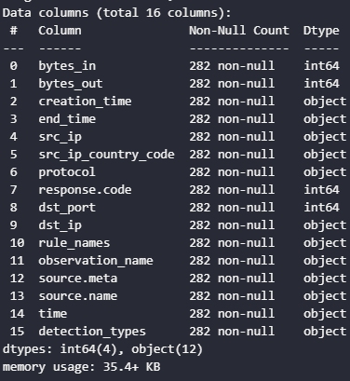
Info about the dataset

Slide 10
Data Preprocessing
Handle missing values, outliers, and data inconsistencies.

Slide 11
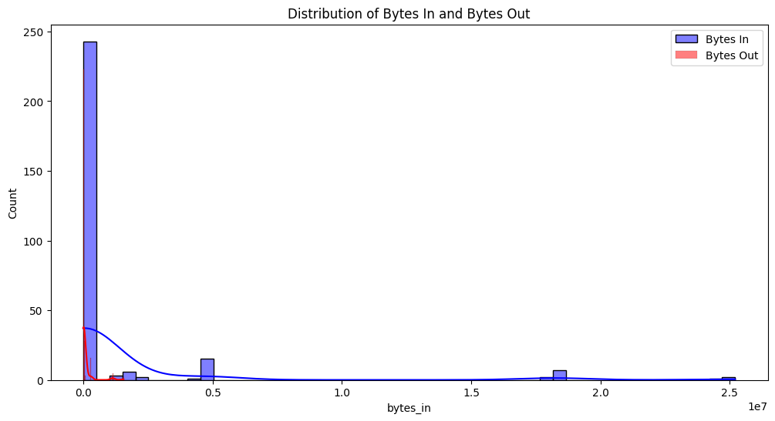
Exploratory Data Analysis (EDA)
Analyze Traffic Patterns Based on bytes_in and bytes_out

Slide 12
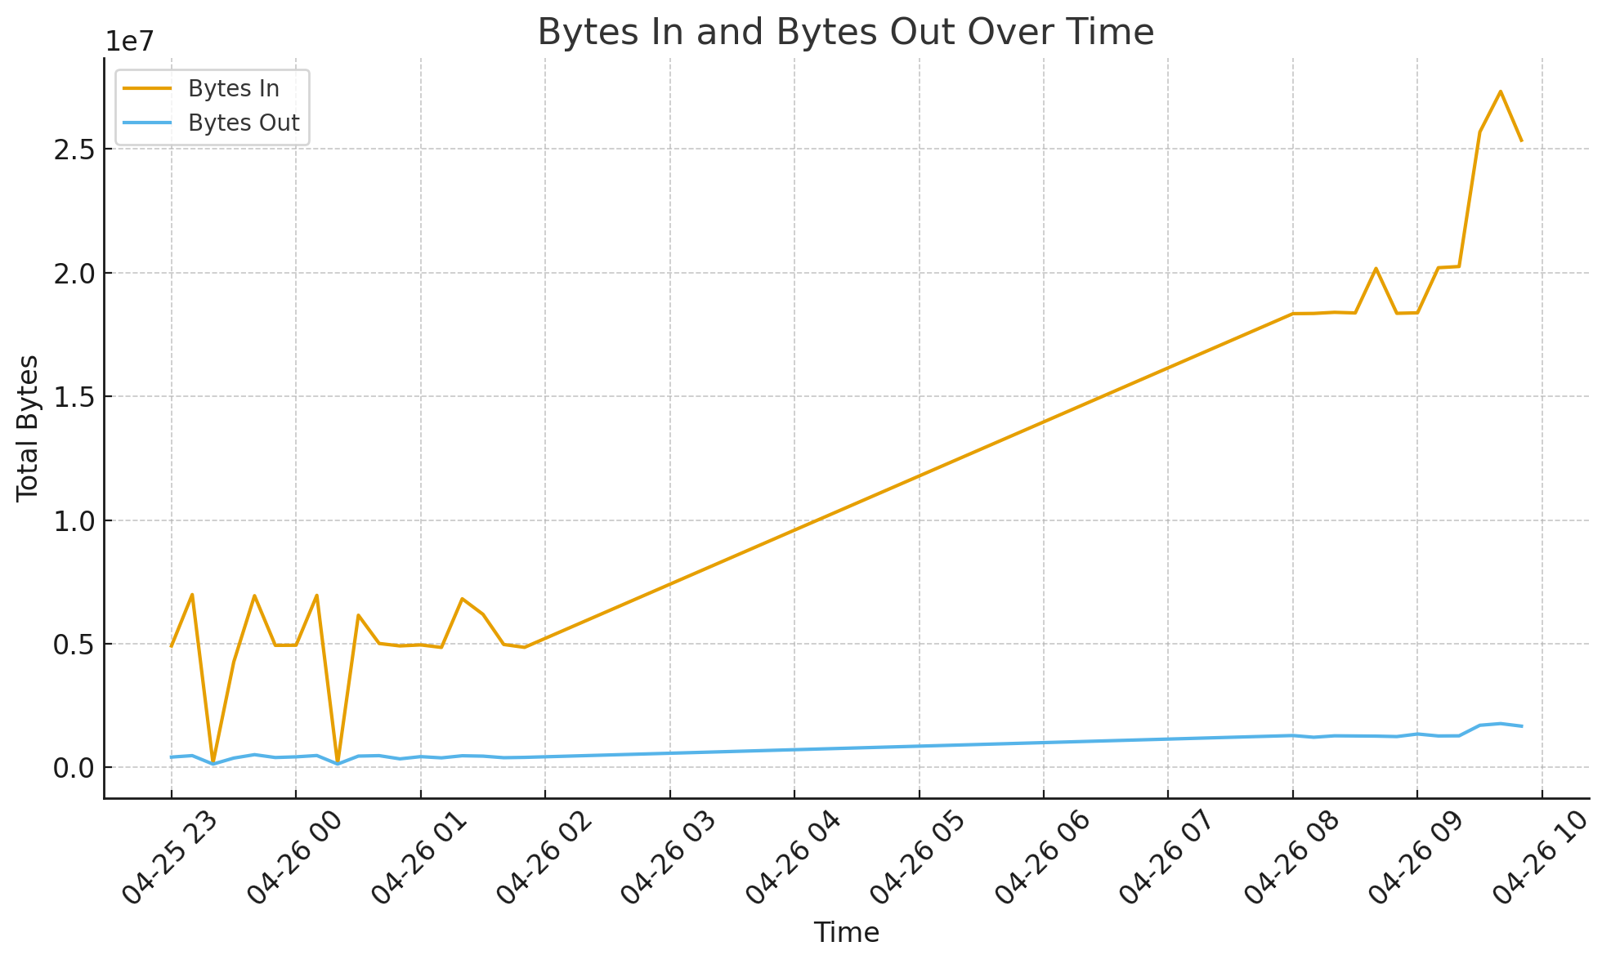
Analyze Traffic Patterns Based on bytes_in and bytes_out

Slide 13
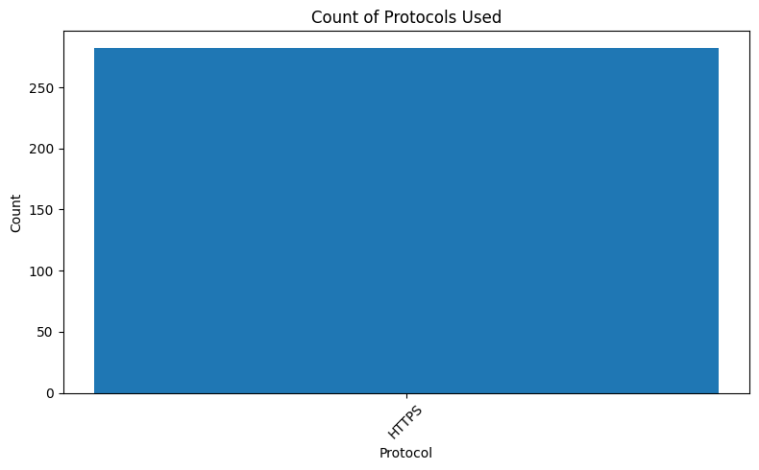
Count of Protocols Used

Slide 14
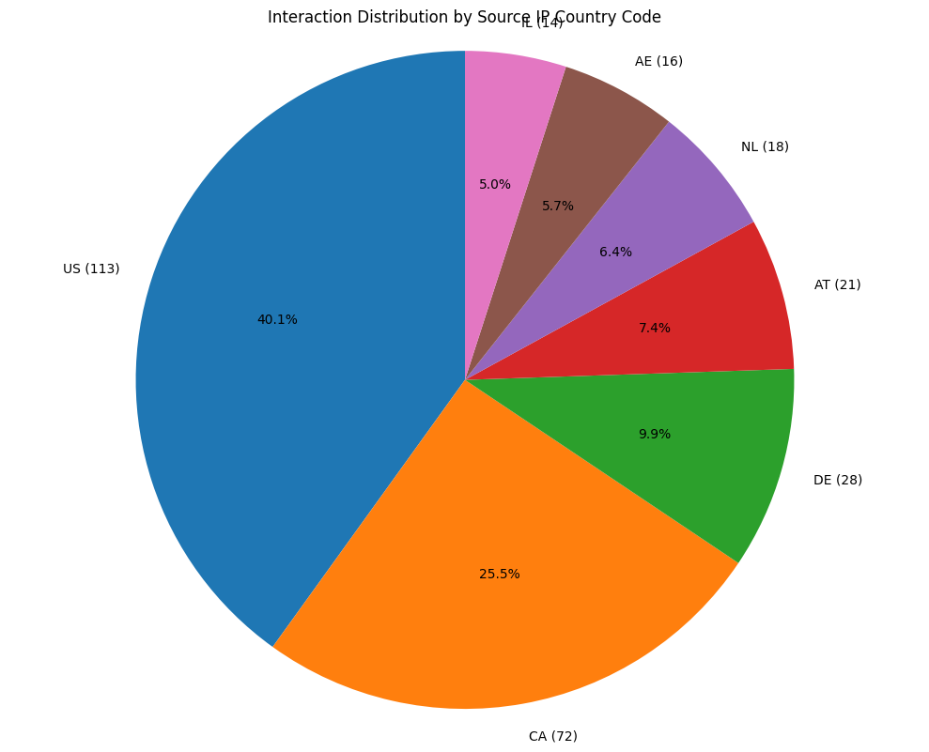
Feature Engineering- Country-based Interaction Analysis

Slide 15
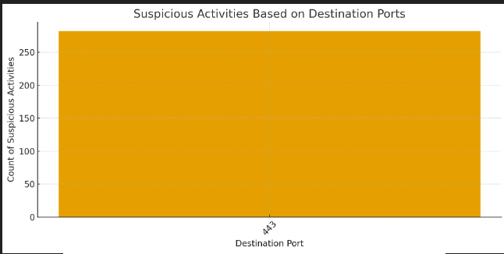
Suspicious Activities Based on Ports

Slide 16
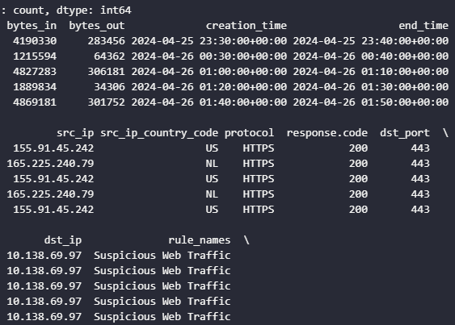
Modeling: Anomaly Detection
This step uses Isolation Forest, a common technique for detecting anomalies.

Slide 17
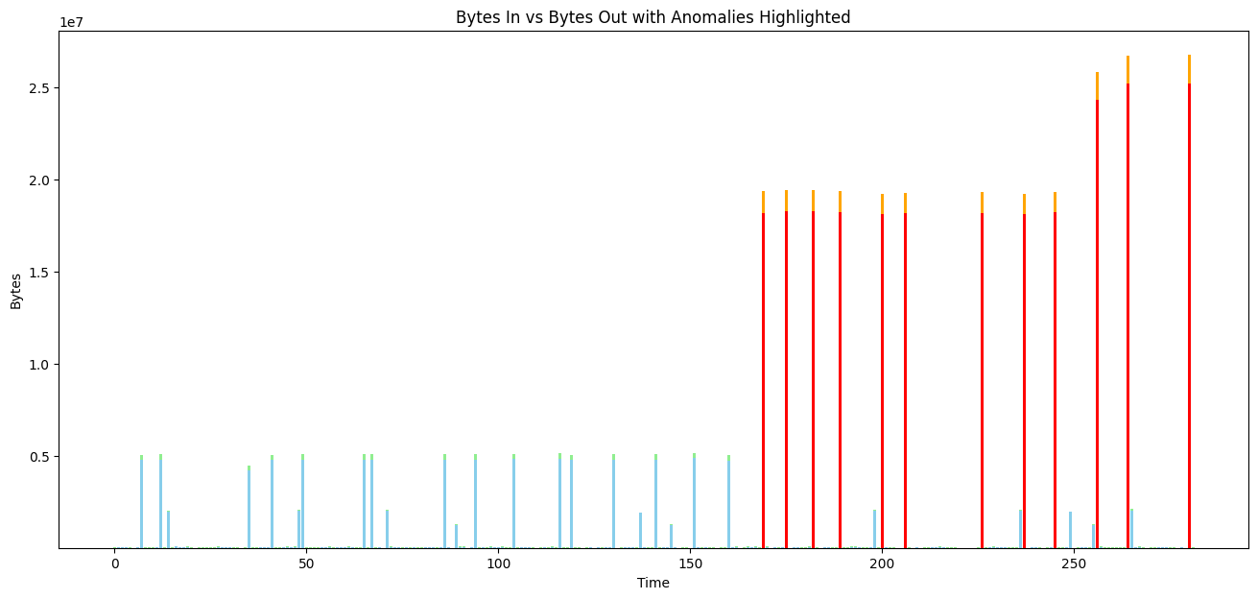
Visualization of Anomalies

Slide 18
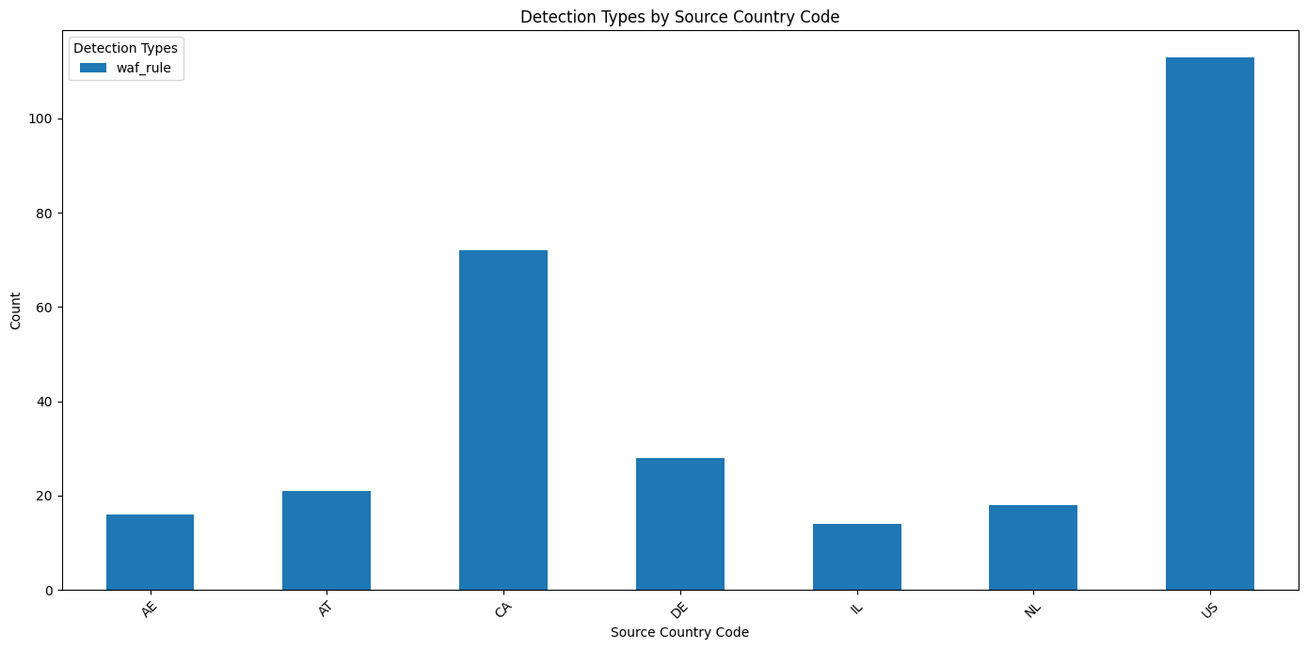
Stacked Bar Chart for Detection Types by Country

Slide 19
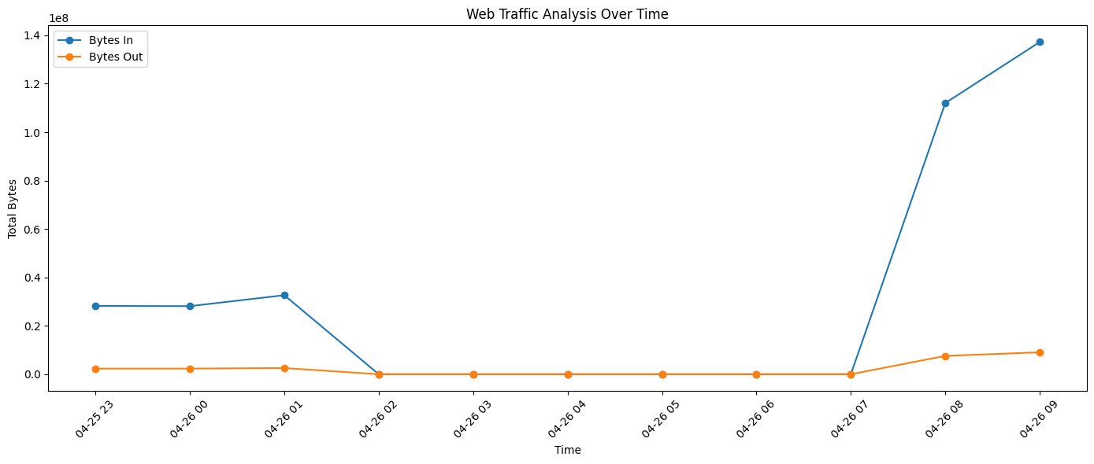
Web Traffic Analysis Over Time

Slide 20
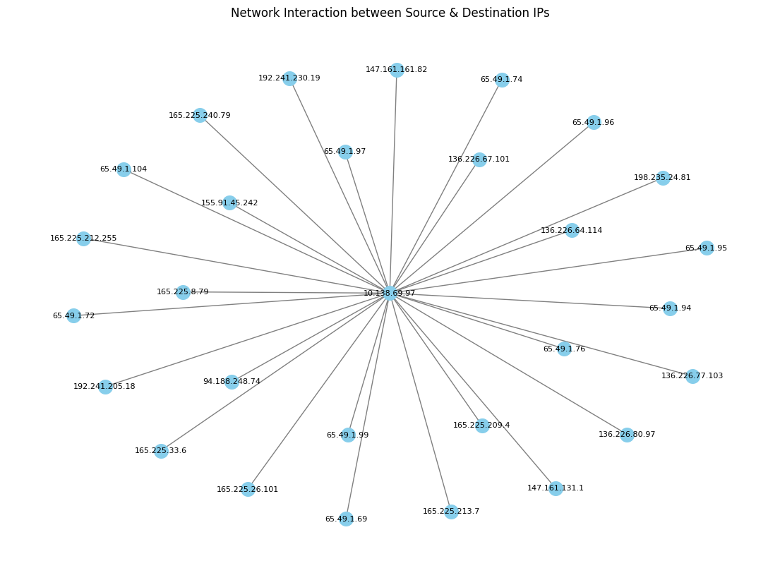
Network Interaction between Source and Destination IPs

Slide 21
Neural Network Model Output

